Slide 1
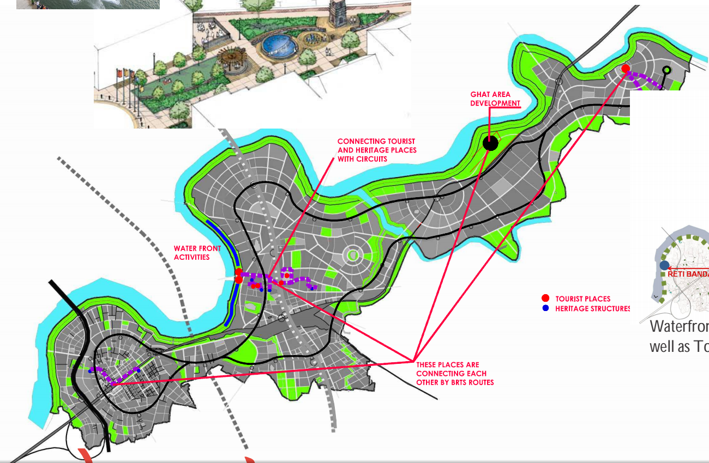



HOME
ABOUT
ACADEMIC INFO
CURRICULUM
PEOPLE
GALLERY
RSUDC
STUDENTS WORK
ALUMNI
CONTACT
RACHANA SANSAD
INSTITUTE OF URBAN AND REGIONAL PLANNING

Slide 2
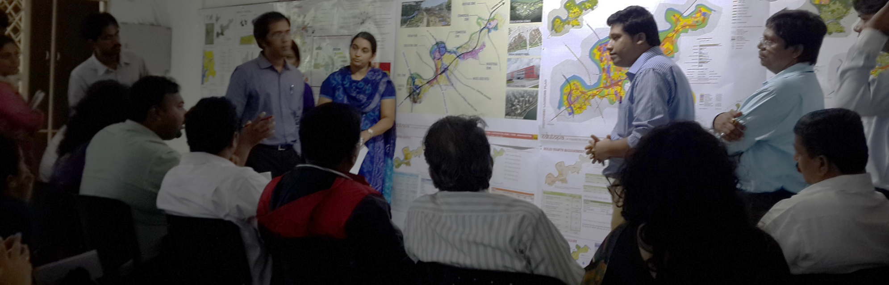
HOME
ABOUT
History
Mumbai, one of the largest urban agglomeration is constantly facing pressures of urbanisation. Rachana Sansad one of the pioneers in education in the field of Architecture and Design started a think tank along with Mumbai Study Group, which worked out the content to start the first school of Urban Planning in 2006, in Mumbai. The Centre for Urban Studies offered a Rachana Sansad Diploma in Urban Studies. However the students were keen to get a Masters degree in Urban and Regional Planning. So in 2008 the Institute of Urban and Regional Planning (IURP), was incepted. IURP, offers a two year Master's Programme in Urban and Regional Planning, affiliated to the YCMOU, Nashik and recognised and approved by Council of Architecture.
Our Philosophy
----------------------------------------------------------------------------------------------------------------------------------------------------------------------------------------------------------------------------------------------------------------------------------------------------------------------------------------------------------------------------------------------------------------------------------------------------------------------------------------------------------------------------------------------------------------------------------------------------------------------------------------------------------------.
ACADEMIC INFO
CURRICULUM
PEOPLE
GALLERY
RSUDC
STUDENTS WORK
ALUMNI
CONTACT
RACHANA SANSAD
INSTITUTE OF URBAN AND REGIONAL PLANNING

Slide 3
HOME
ABOUT
Academic Programme
The objectives of the Institute of Urban and Regional Planning are: To provide an in depth understanding of the complexities of built environment and its correlation to the socio-economic ethos
To provide practical guidance on navigating the legal and regulatory maze.
The course is specially designed to train students in sustainable urban and regional practices by stressing on environmental issues and resource management.
Lack of infrastructure and increase in densities in the developing countries like ours make it imperative to train planners in resource optimization.
Technological advances need to be utilized keeping in mind the ecology and thus stressing in balanced development.
M.Arch. (Urban And Regional Planning) The M.Arch. (Urban And Regional Planning) program is a 2-year Masters Program affiliated to the Yashwantrao Chavan Maharashtra Open University (YCMOU), Nashik and recognized by the Council of Architecture (COA), New Delhi. It is conducted in 'Full time face to face counseling mode' over four semesters of 15 – 18 weeks each (with approximately 20 hours of contact sessions per week). Admissions: Admissions for Semester I will be from 10th June to 31st July 2015 and will be awarded on merit and reservation policy by the University. Prospectus and admission form may be may be collected from the Institute office / downloaded and submitted with relevant documents. The intake capacity is 20-40 seats. For more details, log on tohttp://ycmou.digitaluniversity.ac or click here.
ACADEMIC INFO
CURRICULUM
PEOPLE
GALLERY
RSUDC
STUDENTS WORK
ALUMNI
CONTACT
RACHANA SANSAD
INSTITUTE OF URBAN AND REGIONAL PLANNING
Eligibility
B.Arch or equivalent from a recognized University with min 50% aggregate in the final year.
How to Apply
--------------------------------------------------

Slide 4
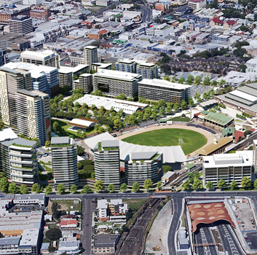
HOME
ABOUT
Curriculum
The course offers two theory subjects per semester one elective and two term papers along with a studio project which is the backbone of the programme and integrates the subjects taught for practical application.
ACADEMIC INFO
CURRICULUM
1St Sem
2nd Sem
PEOPLE
GALLERY
3Rd Sem
4Th Sem
RSUDC
STUDENTS WORK
ALUMNI
CONTACT
RACHANA SANSAD
INSTITUTE OF URBAN AND REGIONAL PLANNING

Slide 5
HOME
ABOUT
Curriculum
The course offers two theory subjects per semester one elective and two term papers along with a studio project which is the backbone of the programme and integrates the subjects taught for practical application.
ACADEMIC INFO
CURRICULUM
1St Sem
2nd Sem
Urban and regional planning theories
Urban and regional planning history
PEOPLE
GALLERY
3Rd Sem
4Th Sem
Traffic & Transport Design
Urban and Rural housing
RSUDC
STUDENTS WORK
Disaster Management
Barrier Free Design
ALUMNI
CONTACT
Disaster Management
Barrier Free Design
RACHANA SANSAD
INSTITUTE OF URBAN AND REGIONAL PLANNING
Urban Regional Planning Studio 1

Slide 6
HOME
ABOUT
Curriculum
The course offers two theory subjects per semester one elective and two term papers along with a studio project which is the backbone of the programme and integrates the subjects taught for practical application.
ACADEMIC INFO
CURRICULUM
1St Sem
2nd Sem
Urban and regional planning theories
Urban and regional planning history
UN 1-1
Urban and Regional Planning principles and considerations.
UN 1-2
Sociology and social science and its relation to physical planning
UN 2-1
Human Aspects of Urban Form
UN 2-2
Economics
PEOPLE
GALLERY
3Rd Sem
4Th Sem
Traffic & Transport Design
Urban and Rural housing
RSUDC
STUDENTS WORK
Disaster Management
Barrier Free Design
ALUMNI
CONTACT
Disaster Management
Barrier Free Design
RACHANA SANSAD
INSTITUTE OF URBAN AND REGIONAL PLANNING
Urban Regional Planning Studio 1

Slide 7
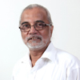
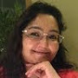
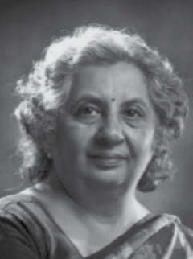
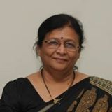
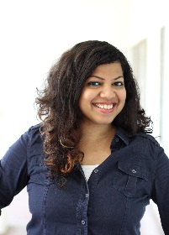

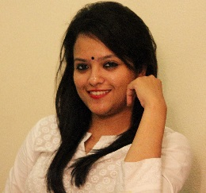
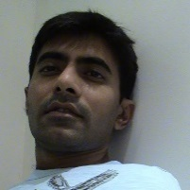
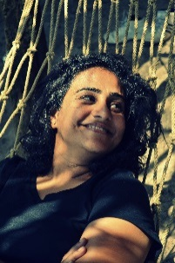
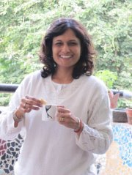
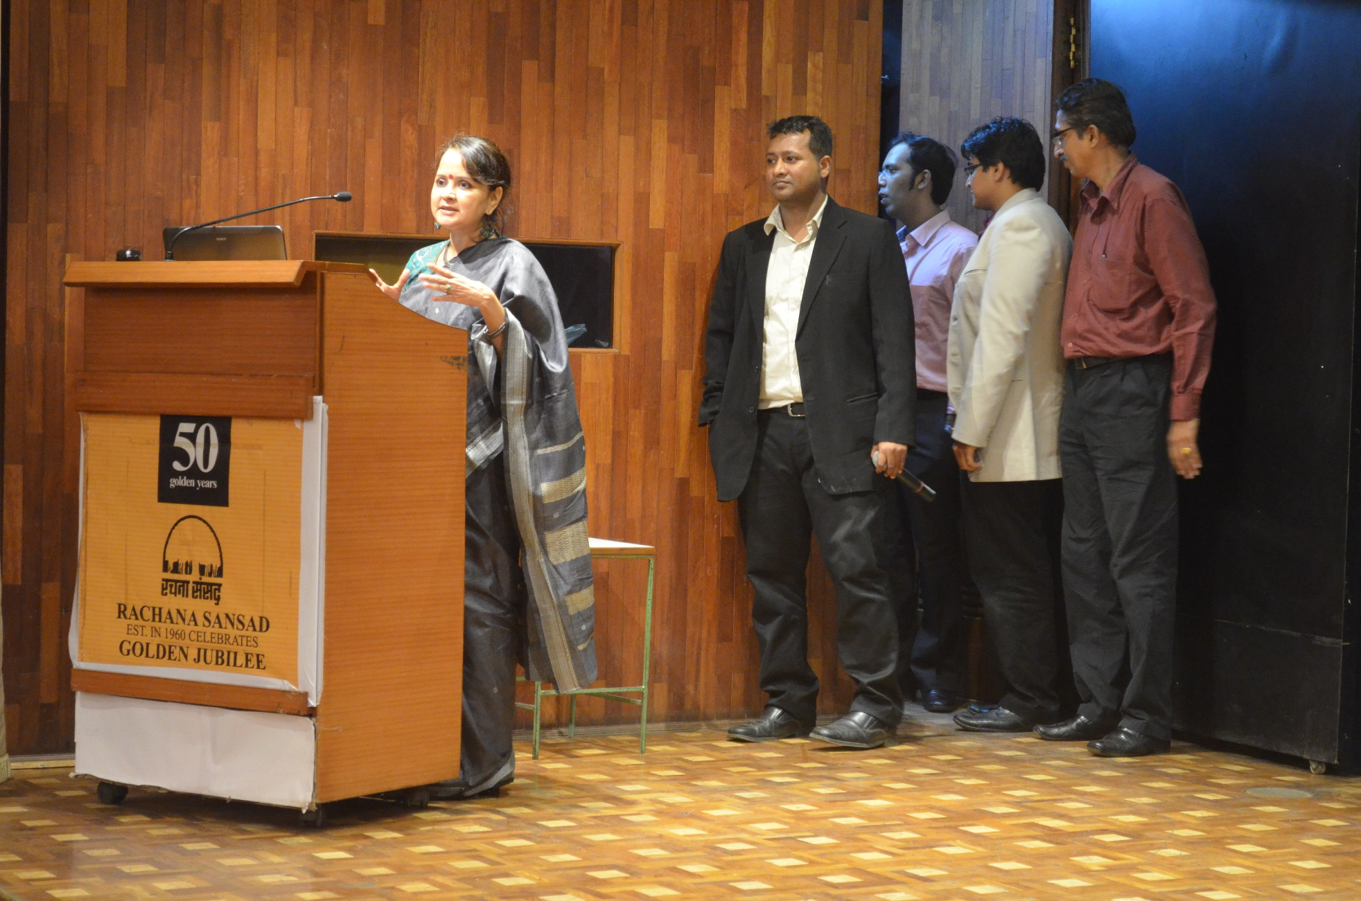
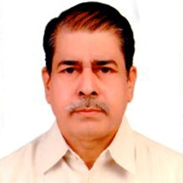
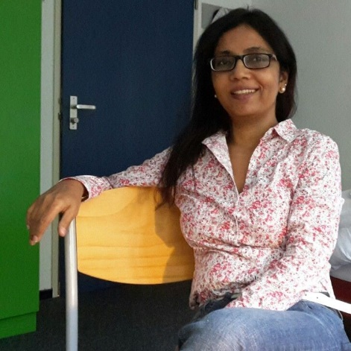
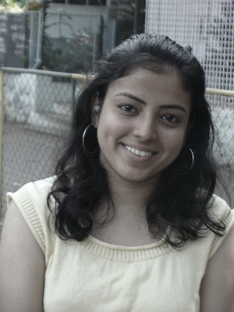
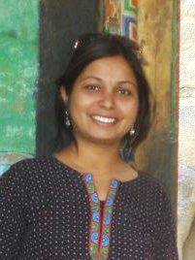
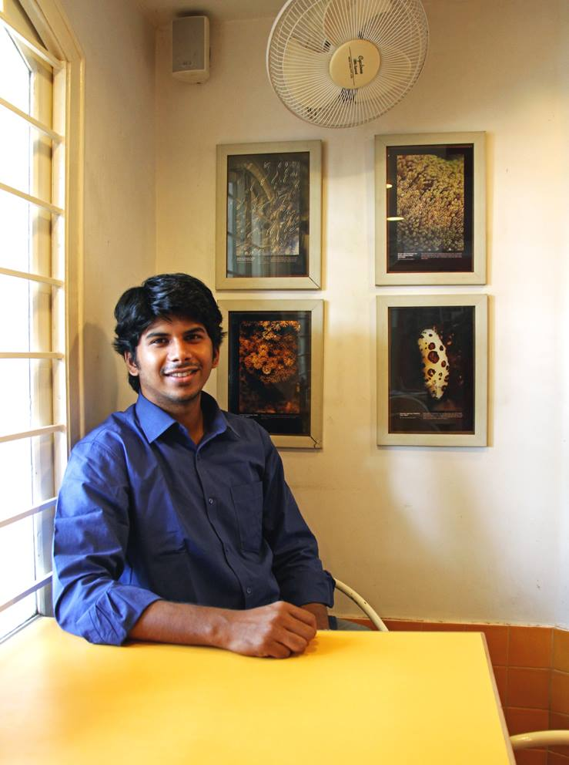
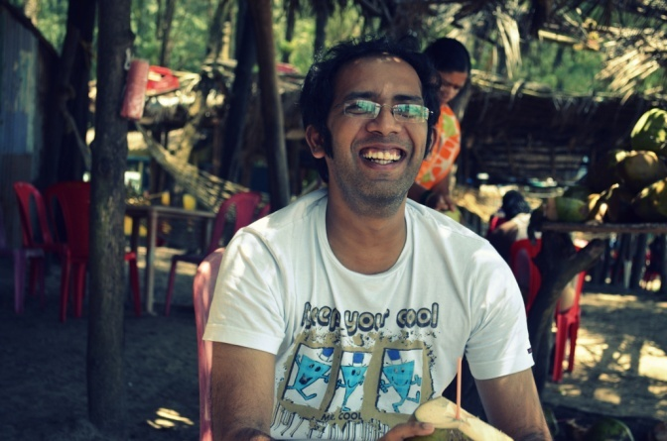
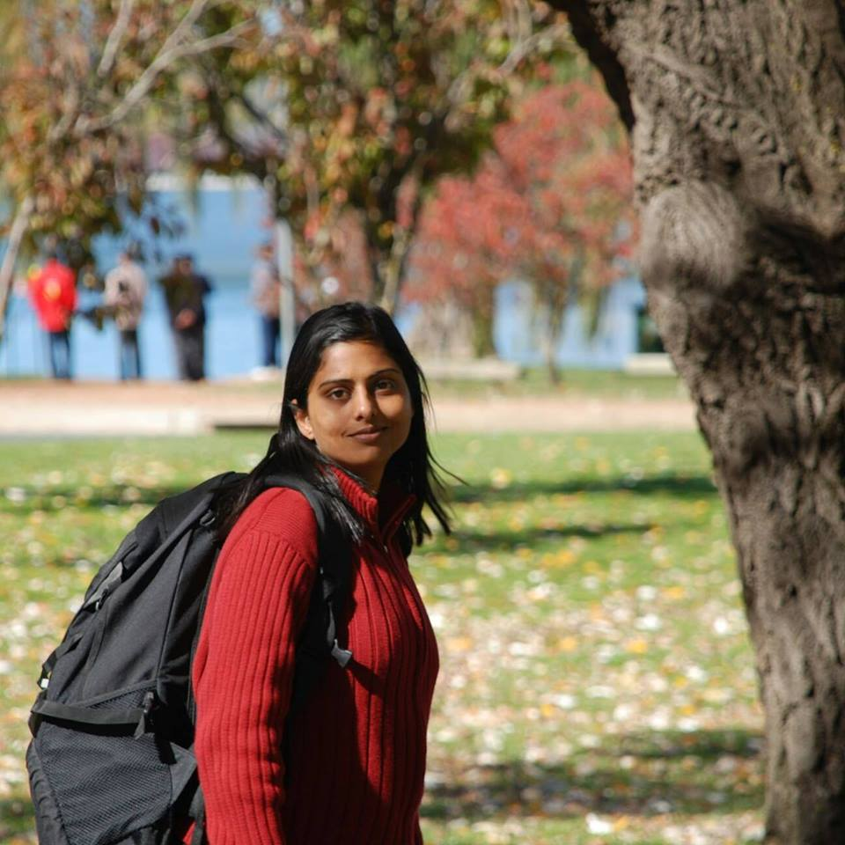
ABOUT
Faculty are appointed for their diverse approach to the sharing of knowledge, their breadth of perspective and their ability to bridge gaps between various academic areas. Some of the RSURP faculty pursue independent research work and publish their work on a regular basis.
HOME
PEOPLE
ACADEMIC INFO
CURRICULUM
PEOPLE
GALLERY
RSUDC
STUDENTS WORK
ALUMNI
CONTACT
RACHANA SANSAD
INSTITUTE OF URBAN AND REGIONAL PLANNING
CORE FACULTY
VISITING FACULTY
Mrs. Gayatri Murudkar
Mr. Manilal
Mr. Sandeep
Mr. Yogesh.
NON TEACHING STAFF

Slide 8

ABOUT
Faculty are appointed for their diverse approach to the sharing of knowledge, their breadth of perspective and their ability to bridge gaps between various academic areas. Some of the RSURP faculty pursue independent research work and publish their work on a regular basis.
HOME
PEOPLE
ACADEMIC INFO
CURRICULUM
PEOPLE
GALLERY
RSUDC
STUDENTS WORK
PRACHI MERCHANT
ALUMNI
CONTACT
RACHANA SANSAD
INSTITUTE OF URBAN AND REGIONAL PLANNING
CORE FACULTY
VISITING FACULTY
Mrs. Gayatri Murudkar
Mr. Manilal
Mr. Sandeep
Mr. Yogesh.
NON TEACHING STAFF

Slide 9
HOME
ABOUT
ACADEMIC INFO
CURRICULUM
PRACHI MERCHANT
Assistant Professor
PEOPLE
GALLERY
She is a Senior Urban Planner at All India Institute of Local Self Government – Revision of Draft Development Plan 2034 of Mumbai for MCGM.
Trained as an Architect-Urban Planner, Prachi has gained a rich experience of 18 years in the fields of Design, Heritage conservation, Urban research and documentation, Urban and rural Planning. Prachi looks at resolving any urban issue with great passion and in an holistic manner. She has a penchant for research, reading, traveling, Indian music, culture, and architecture.
RSUDC
STUDENTS WORK
ALUMNI
CONTACT
RACHANA SANSAD
INSTITUTE OF URBAN AND REGIONAL PLANNING

Slide 10
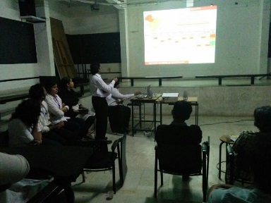
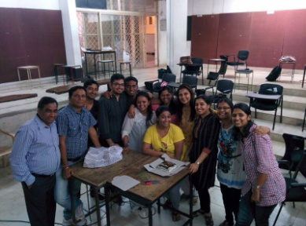
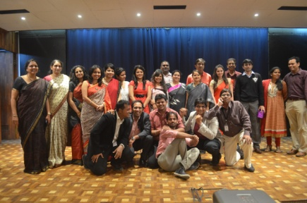
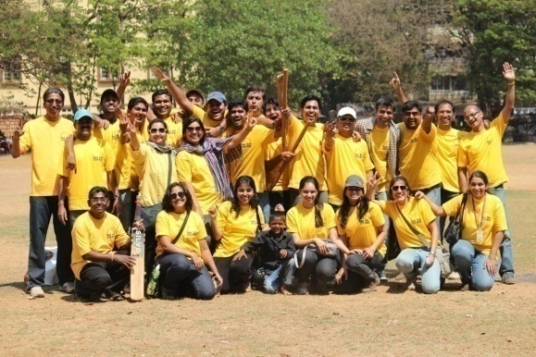
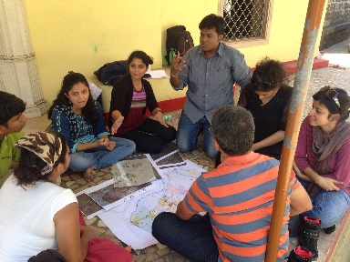
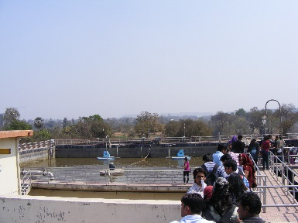
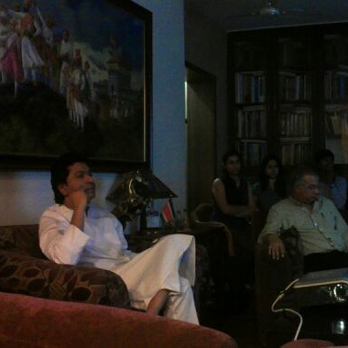
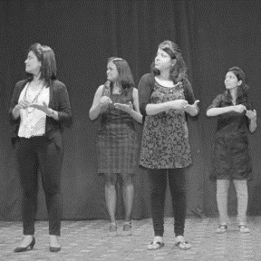
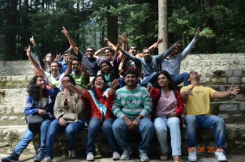
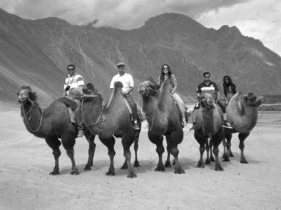
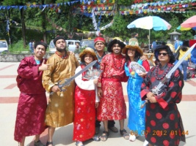
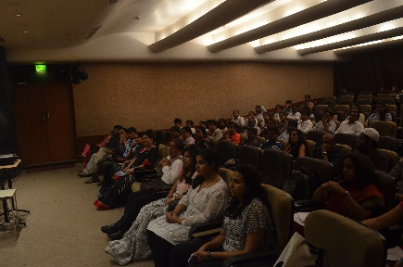
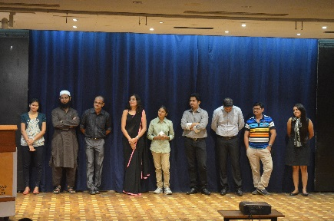
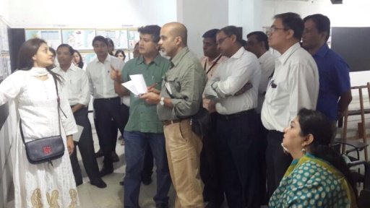
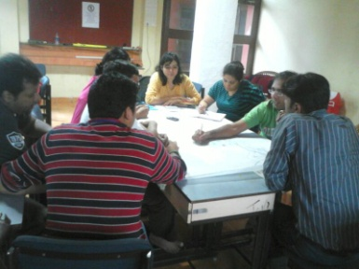
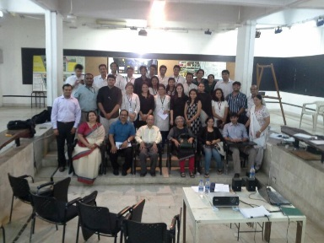
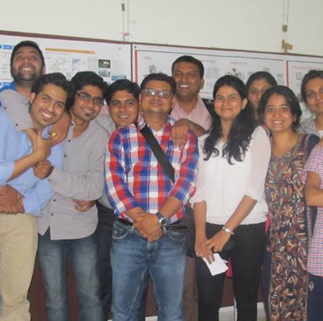
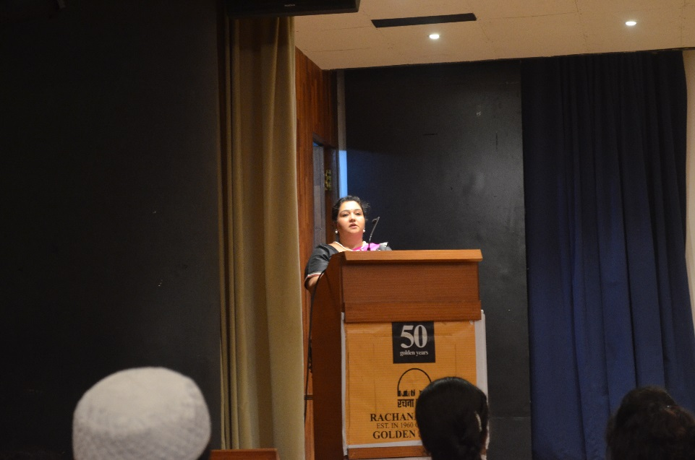
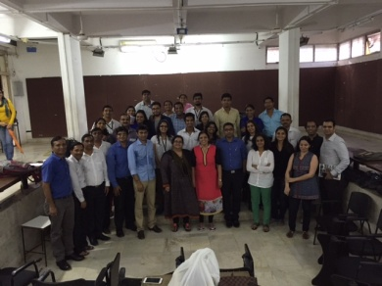
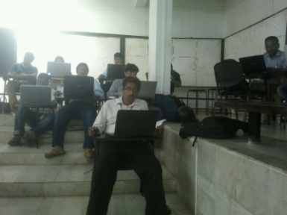
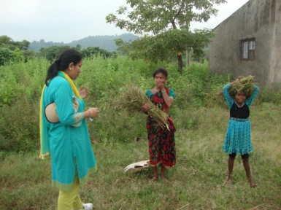
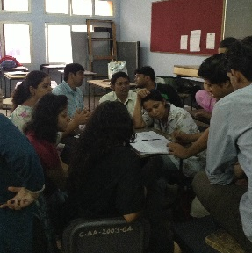
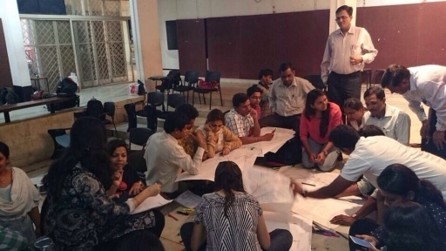
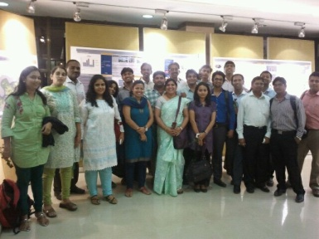
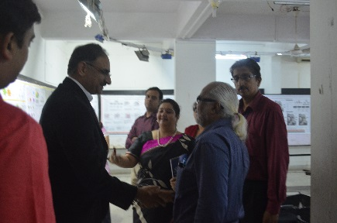
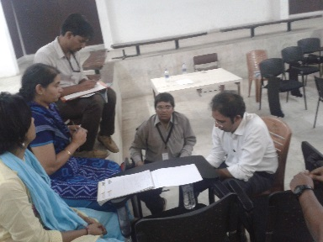
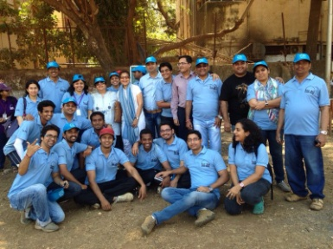
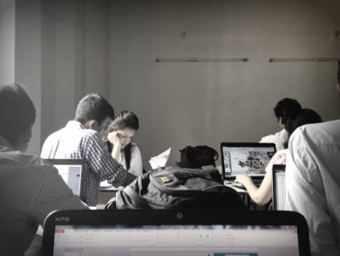
HOME
ABOUT
STUDENT’S LIFE AT RACHANA
ACADEMIC INFO
CURRICULUM
PEOPLE
GALLERY
RSUDC
STUDENTS WORK
ALUMNI
CONTACT
RACHANA SANSAD
INSTITUTE OF URBAN AND REGIONAL PLANNING

Slide 11

HOME
ABOUT
STUDENT’S LIFE AT RACHANA
ACADEMIC INFO
CURRICULUM
PEOPLE
GALLERY
RSUDC
STUDENTS WORK
STUDENT’S TOUR IN NEPAL
ALUMNI
CONTACT
RACHANA SANSAD
INSTITUTE OF URBAN AND REGIONAL PLANNING

Slide 12

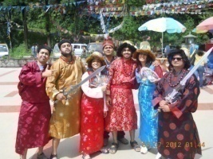
HOME
ABOUT
ACADEMIC INFO
CURRICULUM
PHOTO GALLERY
The
PEOPLE
GALLERY
RSUDC
STUDENTS WORK
ALUMNI
CONTACT
GALLARY
STUDENT’S TOUR IN NEPAL
RACHANA SANSAD
INSTITUTE OF URBAN AND REGIONAL PLANNING

Slide 13
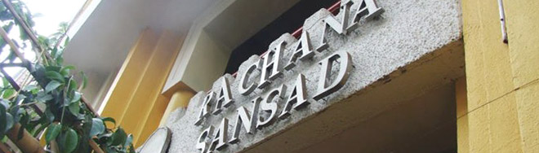
HOME
ABOUT
ACADEMIC INFO
CURRICULUM
PEOPLE
GALLERY
RSUDC
STUDENTS WORK
The Institution
The Institution
Our Vision
Programme Areas
The Team
Rachana Sansad is a 50 year old institution of Mumbai and during its growth and expansion, it has gone beyond just being an educational institution in various ways. It has not only been a pivot in creative education but has also provided a platform for NGOs, citizens, public sector and community to interact on policy and city developmental matters. The unique role of Rachana Sansad is that its approach has consistently been inclusive in nature. As the new development plan is in the process of preparation for MMR and with the introduction of schemes such as JNNURM , public agencies are depending largely on private and civil society groups to play a fellow researcher and services consultant role in project designing, implementation and monitoring. Rachana Sansad with its milieu and pedigree has a huge institutional and human resource advantage which can contribute to this process as well as gain knowledge from it.
ALUMNI
CONTACT
RACHANA SANSAD
INSTITUTE OF URBAN AND REGIONAL PLANNING

Slide 14
HOME
ABOUT
ACADEMIC INFO
CURRICULUM
PEOPLE
GALLERY
RSUDC
STUDENTS WORK
Our Vision
The Institution
Our Vision
Programme Areas
The Team
We believe that transformation in a city can take place only with creation of good public spaces that build local value and meet community needs. We want to become a recognized center for information, resources and best-practices, for converting "Urban spaces to Urban Places". Our vision is to act as the central hub of this "Place making movement". We believe that to create a meaningful urban place the most important starting point is to understand the critical issues of the surrounding fabric and arrive at what is meaningful for the community. Any vision and program developed on the basis of community participation ultimately helps to create a sense of ownership in the development process and product. We believe that to create a meaningful urban place the most important starting point is to understand the critical issues of the surrounding fabric and what is meaningful for the community. The vision and the program developed on the basis of community participation will help to create a sense of ownership in the project. We want to create places not designs. The goal is to create places that have a strong sense of community, places which are lively, secure and have a distinct identity. A place which is democratic that simultaneously addresses multiple interests and concerns.
ALUMNI
CONTACT
RACHANA SANSAD
INSTITUTE OF URBAN AND REGIONAL PLANNING

Slide 15



HOME
ABOUT
Rachana Sansad facilitates a team of professionals, who work under the Institute of Urban and Regional Planning, concentrating on urban research issues and design projects within and outside the city of Mumbai. This group is a team of highly qualified professionals with expertise in diverse fields who are trained in architecture, urban planning, urban design, and environmental planning.
ACADEMIC INFO
CURRICULUM
PEOPLE
GALLERY
RSUDC
STUDENTS WORK
ALUMNI
CONTACT
RACHANA SANSAD
INSTITUTE OF URBAN AND REGIONAL PLANNING
The Team
The Institution
Our Vision
Programme Areas
The Team

Slide 16
HOME
ABOUT
Shivani Singh
Architect Urban Planner & Founder, Institute of Urban & Regional Planning
A dynamic personality with a flair for networking and negotiating owing to strong communication skills. Is a 15 year experience holder & a skillful urban planner from SPA New Delhi, has worked extensively in New Delhi and Madhya Pradesh. Played a vital role in various NGOs, government organizations, action groups for creating development alternatives dealing with rural housing, heritage conservation, appropriate building technologies pan India and all across the Globe. Has keen interest in the graphic art of exhibition paneling and other presentation marketing tools. Has been a faculty at various architecture schools across Mumbai and at present holds the position of the Director, Head, and Institute of Urban & Regional Planning which caters to urban planning & management to create responsive city managers.
ACADEMIC INFO
CURRICULUM
PEOPLE
GALLERY
RSUDC
STUDENTS WORK
ALUMNI
CONTACT
RACHANA SANSAD
INSTITUTE OF URBAN AND REGIONAL PLANNING
The Team
The Institution
Our Vision
Programme Areas
The Team

Slide 17
HOME
ABOUT
Pallavi Latkar,
Architect Landscape Designer and Environmental Researcher
An eminent environmentalist involved strategically in major projects in the region. Has been a recipient of International Research and Travel grants and has also been awarded research grants from Mumbai Metropolitan Environment Society. Is the Founder and Director of Grassroots Research and Consultancy working on ecological issues in urban and regional planning, rain water harvesting techniques for urban and rural areas, energy efficient buildings and green architecture etc.. Has contributed successfully in the fields of eco-sustainability on sustainable planning for infrastructure in SEZs, Environmental Management Plan, Integrated Development Plan responding to ecological issues and impact. Has many articles published under her name including The Shifting Landscape, Integrated Ecological Planning, Urban Water Bodies.
ACADEMIC INFO
CURRICULUM
PEOPLE
GALLERY
RSUDC
STUDENTS WORK
ALUMNI
CONTACT
RACHANA SANSAD
INSTITUTE OF URBAN AND REGIONAL PLANNING
The Team
The Institution
Our Vision
Programme Areas
The Team

Slide 18
HOME
ABOUT
Padma Desai,
Architect Urban Planner
An eminent academician & a principle researcher with a Doctoral research in Program Planning and Management from the Free University, Department of Social Studies, Amsterdam. Has been a part of various NGOs and governmental organizations and programs as an expert on Urban Programs. Has effectively lead a team of Consultants to the World Bank aided Slum Up gradation Program in the city of Ahmadabad. Has done valuable published contributions namely (1999), Slum Redevelopment in Mumbai Rhetoric and Reality, (2001), The Bombay Urban Development Program, Mumbai, India: A Review of Planning Processes, (2002) Slum Redevelopment in Mumbai etc. Has attended various international seminars and presented papers in recent years. Also been a faculty at few architectural schools in Mumbai guiding your professionals through the urban issues of the city
ACADEMIC INFO
CURRICULUM
PEOPLE
GALLERY
RSUDC
STUDENTS WORK
ALUMNI
CONTACT
RACHANA SANSAD
INSTITUTE OF URBAN AND REGIONAL PLANNING
The Team
The Institution
Our Vision
Programme Areas
The Team

Slide 19
HOME
ABOUT
Karim Panjwani,
Urban Designer, head of the department institute of regional planning.
Urban Designer by Profession, with experience of over 6 Years in varied projects spanning from Regional Planning, Development Plans, Urban Renewal and Architecture. He is the head of the Urban planning department with interest in Research Program with Centre for Environmental Planning and Technology, Architect Hafeez Contractor and Prekins East man International.
ACADEMIC INFO
CURRICULUM
PEOPLE
GALLERY
RSUDC
STUDENTS WORK
ALUMNI
CONTACT
RACHANA SANSAD
INSTITUTE OF URBAN AND REGIONAL PLANNING
The Team
The Institution
Our Vision
Programme Areas
The Team

Slide 20



HOME
ABOUT
ACADEMIC INFO
CURRICULUM
Urban Design Cell (UDC) is the formalization & amplification of the non educational and developmental role of Rachana Sansad . A cell on these foundations also brings back the learnings from its projects and consultancies into enriching education.
The role of the cell is:
To provide a formal platform for dialogue between all the stakeholders in the urban development set up.
To provide a formal institutional support to carry out urban design/planning research projects and consultancy assignments
To undertake innovative projects and programs which are in line with the larger goal of building a humane and quitablecity
PEOPLE
GALLERY
RSUDC
STUDENTS WORK
ALUMNI
CONTACT
Urban Design Cell
RACHANA SANSAD
INSTITUTE OF URBAN AND REGIONAL PLANNING
The Institution
Our Vision
Programme Areas
The Team

Slide 21
HOME
ABOUT
ACADEMIC INFO
CURRICULUM
PEOPLE
GALLERY
LANDUSE PLANNING
The pattern of land use of a country at any particular time is determined by the physical, economic and institutional framework taken together. We believe that in current scenario strategic mixed use planning is the key. We think that the time has come to move ahead from traditional zoning patterns and to look at land use planning as tool to guide all the correlated aspects of urban development.
RSUDC
STUDENTS WORK
ALUMNI
CONTACT
Urban Design Cell
RACHANA SANSAD
INSTITUTE OF URBAN AND REGIONAL PLANNING
The Institution
Our Vision
Programme Areas
The Team

Slide 22
HOME
ABOUT
ACADEMIC INFO
CURRICULUM
PEOPLE
GALLERY
SUSTAINABILITY AND ENVIRONMENT
Any development endeavor requires not only the analysis of the demand of the people but also the impacts it will have on the environment at large. It’s our prerogative to identify, evaluate and validate any developmental activity with respect to its long term natural sustenance.
RSUDC
STUDENTS WORK
ALUMNI
CONTACT
Urban Design Cell
RACHANA SANSAD
INSTITUTE OF URBAN AND REGIONAL PLANNING
The Institution
Our Vision
Programme Areas
The Team

Slide 23

HOME
ABOUT
STUDENT’S WORK
2012
2013
ACADEMIC INFO
CURRICULUM
IST
IIND
URBAN ART
EDP - PANVEL
PEOPLE
INQUIRY
2014
2015
SEMESTER
SEMESTER
IIIRD
IVTH
RSUDC
STUDENTS WORK
CDP KDMC
TRANSPORTATION
2016
2017
SEMESTER
SEMESTER
ALUMNI
CONTACT
Sample Text Sample Text Sample Text Sample Text Sample Text Sample Text Sample Text Sample Text Sample Text Sample Text Sample Text Sample Text Sample Text Sample Text Sample Text Sample Text Sample Text Sample Text Sample Text Sample Text Sample Text Sample Text Sample Text Sample Text Sample Text Sample Text Sample
RP - MARATHWADA
THESIS 3
RACHANA SANSAD
INSTITUTE OF URBAN AND REGIONAL PLANNING
THESIS 1
THESIS 2

Slide 24
HOME
ABOUT
STUDENT’S WORK
2012
2013
ACADEMIC INFO
CURRICULUM
IST
IIND
URBAN ART
EDP - PANVEL
PEOPLE
INQUIRY
2014
2015
SEMESTER
SEMESTER
IIIRD
IVTH
RSUDC
STUDENTS WORK
CDP KDMC
TRANSPORTATION
2016
2017
SEMESTER
SEMESTER
ALUMNI
CONTACT
Sample Text Sample Text Sample Text Sample Text Sample Text Sample Text Sample Text Sample Text Sample Text Sample Text Sample Text Sample Text Sample Text Sample Text Sample Text Sample Text Sample Text Sample Text Sample Text Sample Text Sample Text Sample Text Sample Text Sample Text Sample Text Sample Text Sample
RP - MARATHWADA
THESIS 3
RACHANA SANSAD
INSTITUTE OF URBAN AND REGIONAL PLANNING
THESIS 1
THESIS 2

Slide 25
HOME
ABOUT
STUDENT’S WORK
2012
2013
ACADEMIC INFO
CURRICULUM
IST
IIND
URBAN ART
EDP - PANVEL
PEOPLE
INQUIRY
2014
2015
SEMESTER
SEMESTER
IIIRD
IVTH
RSUDC
STUDENTS WORK
CDP KDMC
TRANSPORTATION
2016
2017
SEMESTER
SEMESTER
ALUMNI
CONTACT
Sample Text Sample Text Sample Text Sample Text Sample Text Sample Text Sample Text Sample Text Sample Text Sample Text Sample Text Sample Text Sample Text Sample Text Sample Text Sample Text Sample Text Sample Text Sample Text Sample Text Sample Text Sample Text Sample Text Sample Text Sample Text Sample Text Sample
RP - MARATHWADA
THESIS 3
RACHANA SANSAD
INSTITUTE OF URBAN AND REGIONAL PLANNING
THESIS 1
THESIS 2

Slide 26
HOME
ABOUT
ACADEMIC INFO
CURRICULUM
Regional Plan : Nashik
Regional Plan : Indore
PEOPLE
GALLERY
DOCUMENT
RSUDC
STUDENTS WORK
ALUMNI
CONTACT
RACHANA SANSAD
INSTITUTE OF URBAN AND REGIONAL PLANNING

Slide 27


HOME
ABOUT
Alumni
The connection you will make with us will be for lifetime. Rachana offers alumni many ways to stay connected with each other and the institution. Some of them visit the institution regularly during juries or annual function.
2009
-
2011
2010
-
2012
2011
-
2013
2012
-
2014
2013
-
2015
2014
-
2016
2015
-
2017
ACADEMIC INFO
CURRICULUM
PEOPLE
GALLERY
RSUDC
STUDENTS WORK
ALUMNI
CONTACT
News or Events for Alumni
Volunteer oportunities
I came to the institute with some experience in the urban planning field and initially thought that 'I knew it all' but I must admit that the 2 years that I spent in RSIURP doing URP formal studies were totally worth and opened up many unknown arenas for me.
PRACHI MERCHANT
RACHANA SANSAD
INSTITUTE OF URBAN AND REGIONAL PLANNING

Slide 28






















HOME
ABOUT
Alumni
The connection you will make with us will be for lifetime. Rachana offers alumni many ways to stay connected with each other and the institution. Some of them visit the institution regularly during juries or annual function.
2012
-
2014
ACADEMIC INFO
CURRICULUM
PEOPLE
GALLERY
RSUDC
STUDENTS WORK
ALUMNI
CONTACT
News or Events for Alumni
Volunteer oportunities
RACHANA SANSAD
INSTITUTE OF URBAN AND REGIONAL PLANNING

Slide 29
HOME
ABOUT
Alumni
The connection you will make with us will be for lifetime. Rachana offers alumni many ways to stay connected with each other and the institution. Some of them visit the institution regularly during juries or annual function.
2012
-
2014
ACADEMIC INFO
CURRICULUM
PEOPLE
GALLERY
SAMEER DESAI
arch.srd@gmail.com
CURRENT DESIGNATION:
Proprietor of Architect's firm at Virar.
Studying in Rachana was a great learning experience. It broaden our vision and gave different perspective to look around us. The importance of team work was also underlined. Thanks to all friends, faculties and supporting staff of Rachana.
RSUDC
STUDENTS WORK
ALUMNI
CONTACT
I came to the institute with some experience in the urban planning field and initially thought that 'I knew it all' but I must admit that the 2 years that I spent in RSIURP doing URP formal studies were totally worth and opened up many unknown arenas for me.
PRACHI MERCHANT
RACHANA SANSAD
INSTITUTE OF URBAN AND REGIONAL PLANNING

Slide 30
HOME
ABOUT
Alumni
The connection you will make with us will be for lifetime. Rachana offers alumni many ways to stay connected with each other and the institution. Some of them visit the institution regularly during juries or annual function.
2012
-
2014
ACADEMIC INFO
CURRICULUM
PEOPLE
GALLERY
ANUJA
PANCHAL
arch.srd@gmail.com
CURRENT DESIGNATION:
Associate Manager: Architecture & Urban Planning Dept., Aakar Abhinav Consultants Pvt. Ltd., CBD Belapur.
I joined Rachana Sansad in second yr of M.Arch. URP, and I must say it was worth changing the college. It was a great experience in Rachana with all faculties and Classmates :)
RSUDC
STUDENTS WORK
ALUMNI
CONTACT
I came to the institute with some experience in the urban planning field and initially thought that 'I knew it all' but I must admit that the 2 years that I spent in RSIURP doing URP formal studies were totally worth and opened up many unknown arenas for me.
PRACHI MERCHANT
RACHANA SANSAD
INSTITUTE OF URBAN AND REGIONAL PLANNING

Slide 31

HOME
ABOUT
Address
Contact Form
Rachana Sansad 278 Shankar Ghanekar Marg Prabhadavi Mumbai-400025 Tel:(022)24301024 / 24310807 E-Mail: urban@rachanasansad.in
Name
ACADEMIC INFO
CURRICULUM
Email
PEOPLE
GALLERY
Phone Number
RSUDC
STUDENTS WORK
Message
ALUMNI
CONTACT
Send Message
RACHANA SANSAD
INSTITUTE OF URBAN AND REGIONAL PLANNING

